Slide 1
Mechanics of
Cannabis in Iowa
March 2023
Andrea Hoyt, Compliance Program Manager
Bureau of Cannabis Regulation

Slide 2
What We’ll Cover
Intro to Medical Cannabis
Consumable Hemp
  Realities & Challenges
Disclaimer: any mentions of brands are NOT an endorsement of said products by the Department and are used purely for example!

Slide 3
Ch. 124E – “Medical Cannabidiol Act”
Iowa’s medical cannabidiol program authorizes the manufacture and sale of products that contain both CBD and THC… In other words, it is a program that allows for the legal manufacture and sale of medical cannabis products.
  Iowa prohibits smokable/combustible cannabis, and edibles
  Iowa is the only state to use this terminology for “medical cannabis,” this is due to the initial bill passed in 2017 being elaborated on
Allows for in-state licensing of manufacturers and dispensaries
  Licensing of two in-state manufacturers:
    Bud & Mary’s Cannabis Co. – Des Moines, IA
    Iowa Cannabis Co. – Iowa City, IA
  Licensing of five in-state dispensaries:
    Bud & Mary’s Cannabis Co: Windsor Heights, Sioux City
    Iowa Cannabis Co: Council Bluffs, Waterloo, Iowa City
  Can only be increased by legislature. Other states may have loose or no restrictions of the number of licenses.

Slide 4
Qualifying Debilitating Medical Conditions
Cancer – if the illness or its treatment produces one or more of the following: severe or chronic pain, nausea or severe vomiting, cachexia or severe wasting.
Seizures
Crohn’s disease
Intractable Pain Chronic pain
  original petition Approved by Advisory Board, but Denied by Board of Medicine. Later added by Legislature
  Board of medicine denial was largely due their concerns with how it's addition would grow the program
Multiple Sclerosis with severe and persistent muscle spasms
AIDS or HIV (as defined in Iowa Code, section 141A.1)
Amyotrophic lateral sclerosis (ALS)
Parkinson’s disease
Post-Traumatic Stress Disorder (PTSD)
  Original petition Approved by Advisory Board, but denied by Board of Medicine. Later added by Legislature.
Any terminal illness with a probable life expectancy of under one year
Ulcerative colitis
  original petition approved by Advisory Board and Board of Medicine
Severe, intractable pediatric autism with self-injurious or aggressive behaviors
  original petition approved by Advisory Board and Board of Medicine
Severe, intractable autism with self-injurious or aggressive behaviors
  Original petition Approved by Advisory Board, but denied by Board of Medicine. Later added by Legislature.
Corticobasal Degeneration
  original petition approved by Advisory Board and Board of Medicine

Slide 5
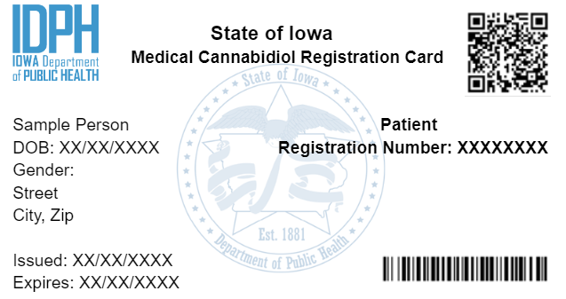
Registration Card
Switched to digital cards July 6th, 2022
QR code allows for 24/7 law enforcement verification
Once issued, cards are effective for 365 days from the date of issuance.
Patients must renew their card each year

Slide 6
Current Realities of Medical Cannabis in Iowa
There are high-THC products available, just as in adult use states
Generally speaking, patients are selecting their products
  Practitioners are not providing dose-frequency guidance (certification vs. prescription)
Patients may be legally in possession of products from other states
  Reciprocity with allowed forms, affirmative defense

Slide 7
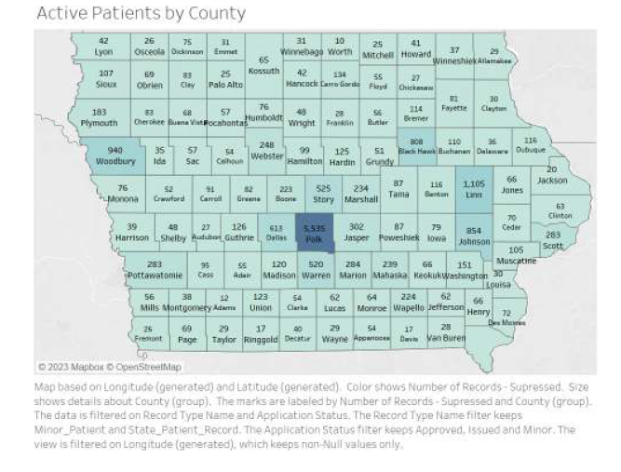
Active Patients by County

Slide 8
Consumable Hemp

Slide 9
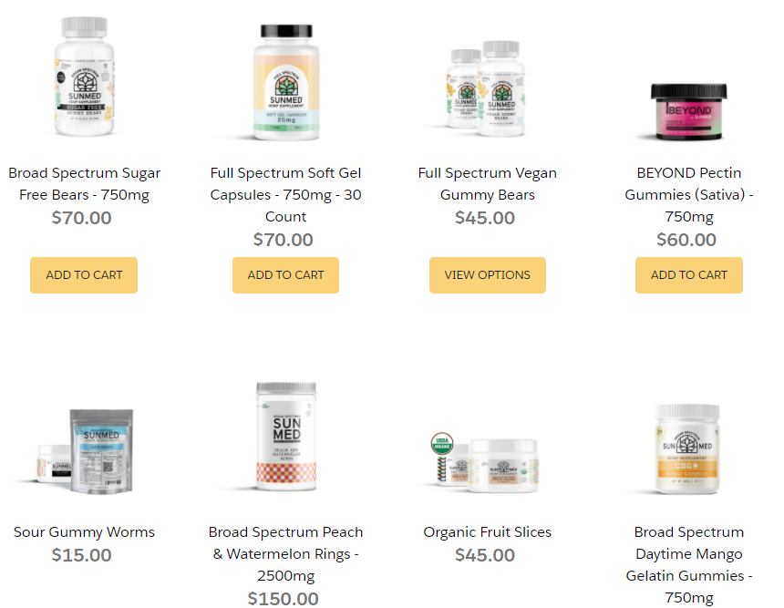
Iowa’s “Consumable Hemp” Program
During the 2020 session, the legislature created the consumable hemp program, which is now regulated by HHS
It allows for the manufacture and retails sales of “cannabinoid hemp products,” many of which are intoxicating
There is no age restriction for purchases or possession.
Combustible or vaporizable consumable hemp products are prohibited
A noncombustible form of hemp that may be digested, such as food; internally absorbed, such as chew or snuff; or absorbed through the skin, such as a topical application (oils and lotions)

Slide 10
New Phenomenon: Intoxicating THC Derivatives
A new phenomenon in the hemp industry, is the proliferation of psychoactive hemp products made from hemp-derived THC
Is Delta-8/6/10 legal to sell in Iowa?
  Pursuant to Iowa Code 124.204 subsection 7, paragraph b, as updated by the 89th General Assembly (HF 391) a hemp product may only contain a maximum tetrahydrocannabinol (THC) concentration that does not exceed three-tenths of one percent (0.3%) on a dry weight basis to be excluded from Schedule I of the Iowa Controlled Substance Act. Therefore, a hemp product may contain any tetrahydrocannabinol isomer, Delta-6/8/9/10 or otherwise, or any combination thereof, so long as the combined total concentration of all THC isomers in the hemp product does not exceed 0.3% on a dry weight basis.
Generally speaking, these products are widely available

Slide 11
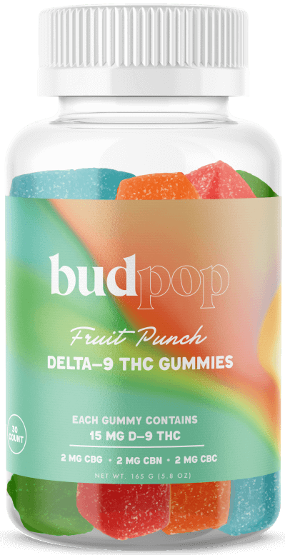
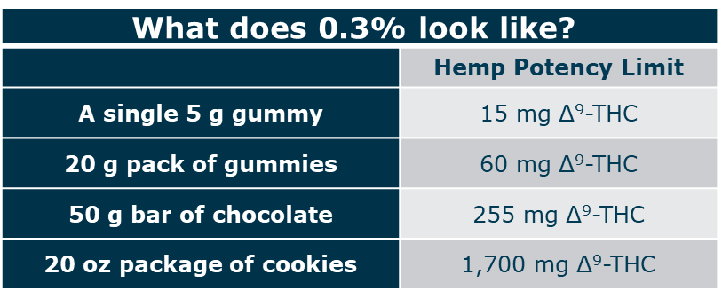
Consumable Hemp – Heavy Edibles
Common misconception: Hemp is not intoxicating
Reality: The federal definition of hemp has loopholes that allow for a wide variety of intoxicating hemp products with little to no regulation
Loophole: The 0.3% THC limit applies by weight to all products, not just flower
Result: Edibles with large doses of THC that scale with the product weight
A bottle of hemp gummies containing 15 mg THC per serving, and 450 mg THC per container

Slide 12
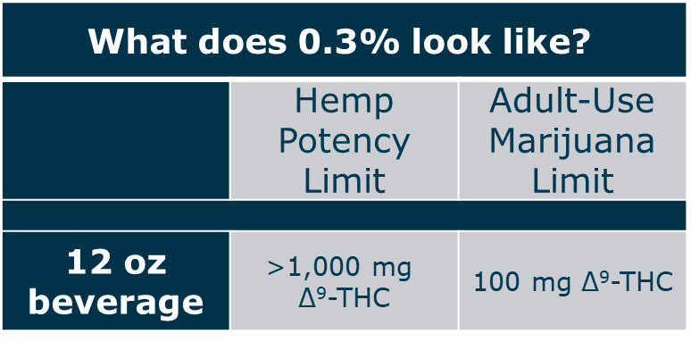
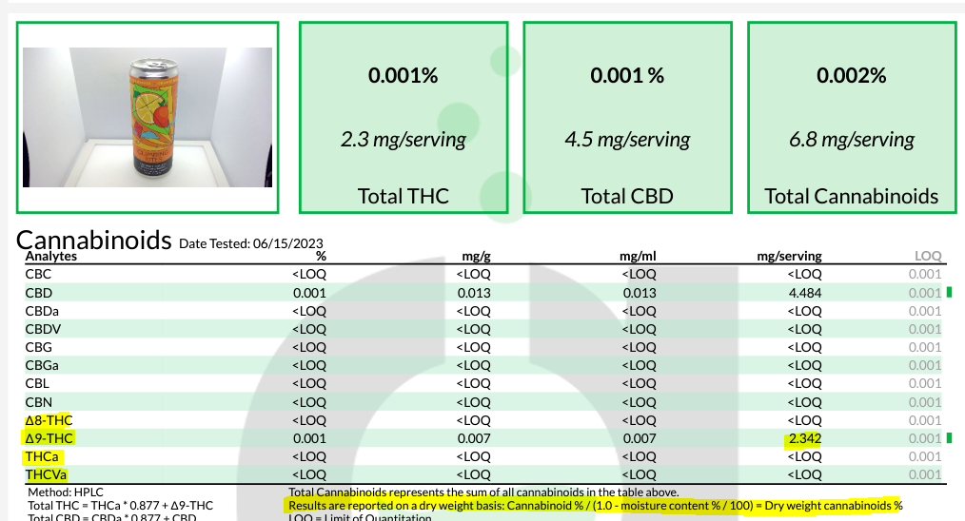
Consumable Hemp - Drinkables
Common misconception: Hemp is not intoxicating
Reality: The federal definition of hemp has loopholes that allow for a wide variety of intoxicating hemp products with little to no regulation
Loophole: The 0.3% THC limit applies by weight to all products, not just flower
Result: Drinkable products with large doses of THC that scale with the product weight
12fl oz = 340 g
0.3% of 354g = 1.02 g
1.02 g = 1,002 mg THC (legal)
2.3, or 5, or 10 mg THC/serving is well below legal limit

Slide 13


Why 0.3% Doesn’t Functionally Work
1 Liter Water = 1,000 grams
0.003*1000 grams = 3 grams
=3,000 mg
1 Liter Water + 3 Cups Sugar = 1,600 grams
0.003*1600 grams= 4.8 grams
=4,800 mg
To increase the total THC a product can have, just add heavy excipients

Slide 14
HF 2605
Limits THC to 4 mg per serving, 10 mg per container
Establishes civil and criminal penalties to unregistered businesses
Sets age minimum of 21
Codifies prohibition of consumable hemp + alcohol

Slide 15
Consumable Hemp in Restaurants
Consumable hemp products may not be added as an ingredient during the manufacturer or processing of alcoholic beverages, meat and poultry products, or dairy products.
Food service establishment that is utilizing a consumable hemp product from an approved hemp source as a food ingredient used for immediate consumption by the consumer may add consumable hemp products to food or beverages. Packaging and labeling requirements apply
Food licensing rules still apply!

Slide 16
Consumable Hemp and Alcohol
Prohibited to introduce consumable hemp into any alcoholic beverage (641 IAC 156.5(2))
Consumable hemp mocktails are okay!
https://abd.iowa.gov/sites/default/files/media/publications/thc-and-cbd-in-alcoholic-beverages-7.13.22-regulatory-bulletin_0.pdf

Slide 17
What about THC while driving?
Iowa has a zero-tolerance policy for operating a vehicle while under the influence of THC (medical cannabis OR consumable hemp)
  Iowa Code 321J.2
Difficult to enforcement because no standardized sobriety test for cannabis
THC will show up on a drug test up to 90 days after consumption

Slide 18
Public Impairment
Medical card or legality of consumable hemp does NOT permit public impairment
  Iowa Code 123.46(3); charged under simulated intoxication

Slide 19
Signs of THC Intoxication
Decreased short-term memory
Dry mouth
Impaired perception and motor skills
Red eyes
Dizziness

Slide 20
Dram Shop Insurance
Policy Specific, varies greatly

Slide 21
Important Links
HHS Consumable Hemp Website
  https://hhs.iowa.gov/programs/programs-and-services/consumable-hemp
FAQs
  https://idph.my.site.com/consumablehemp/s/faq
Registration Portal
  https://idph.my.site.com/consumablehemp/s/login/?ec=302&startURL=%2Fconsumablehemp%2Fs%2F

Slide 22
Thank You medical.cannabidiol@idph.iowa.gov consumable.hemp@idph.iowa.gov

